Slide 1
Computational Physics
(Lecture 2)
PHY4061

Slide 2
Computer Simulation vs. Computer modeling
Simulation:
  Assume:
    the Hamiltonian is given from experiment (for example the non-relativistic Schrodinger equation with coulomb interactions).
    Most of the basic equations in condensed matter physics are all well-known.
    It is just a question of working out the details.
    What properties of a many-body system can we calculate without making any uncontrolled approximations?
    A simulation expert is essentially an applied mathematician?

Slide 3
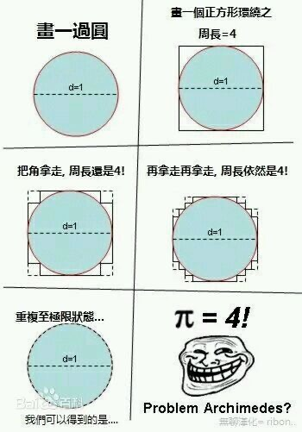
    No!
    physics knowledge and intuition to figure out which simulations to do, which properties to measure etc.,
    just like an experimentalist needs to do more than read the output of the apparatus.
    One example of a bad simulation.
    What went wrong?
    Could it become a good approximation?
    Good approximation is good physics.

Slide 4

Computer Simulation vs. Computer modeling
Modeling:
  allowed to invent new equations and algorithms to describe some physical system.
  Invent a fictitious model with some dynamics that is easy to do on a computer and do systematic studies of the properties of the model.
  might investigate whether some physical systems are described by the model.
  Clearly this approach is warranted in such fields as economics, ecology, biology ...
  since the "correct" underlying description has not always been worked out…
Simulation or modeling?
  The movie “The Matrix”
  Are we in a simulation or modeling?

Slide 5
Challenges in computational physics
The theoretical (mathematical) underpinnings
  We must understand all the approximations and errors since we want to control all of the errors.
  The generic problems with simulations.
    The fundamental problem: computer time is limited!
    The number of particles, the size of the size, the complexity of interactions, and the total length of the simulation are much smaller or shorter than the real world.
    All simulation results have statistical errors and computational errors.
      We have to be able to control the effects of these limitations.
      Empirical vs. First principles
  What is the optimal algorithm for a given problem?
    Potential of algorithm designs.

Slide 6
  How do we measure the performance of an algorithm?
    Important problems take a great deal of computer resources
      importance sampling
      How do we achieve the importance distribution?
    Self consistence.
      Some properties obtained from the approximation are physical,
      others are not.
      Is it a good approximation?
    Optimization is important!
      In the past, the efficiency of simulations has increased more because of better algorithms than computer hardware.

Slide 7
Challenges in Computational physics
Analysis of results.
  All simulations produce are numbers.
  Usual theory produces equations.
  How do we go from numbers to "understandings" ?

Slide 8
Important Issues of this course
Programming and debugging techniques. How do we gain confidence that the computer code is correct: it is doing what we think it should be doing?

Slide 9
Important things in this course
Research aspects. We will not treat a code as a black box. We will attempt to explain the logic behind why things are done in a particular way.
In the class project you will be writing pieces of code. This is the way to understand how it all works and how to do research in the field.

Slide 10
Important things in this course
What are the outstanding challenges?
Which properties can't we simulate?
Classical simulations of simple properties are in relatively good shape unless you have a system that requires many particles or long time scales. (For example, the propagation of a crack, the movements of proteins etc.)
Quantum systems (correct theory for microscopic phenomena) are much harder!

Slide 11
Arrangement of the course
We’ll try to learn how to optimize the total energy of a many-body system with conjugate gradient and steepest decent method.
  However, you need knowledge in the simulation cells and periodic boundary conditions
  Only covered in solid state physics class…We are ahead of them.
Therefore, we’ll briefly introduce the fundamentals in crystal to help you go through project A.
  What if I am an astrophysics or particle physics lover?
    The optimization scheme also works for other systems

Slide 12
Random processes

Slide 13
Random number generation
Randomness
  a property of an infinite sequence
    x_{i} with i = 1, 2, . . . .
    Impossible to tell whether a single number is random or not.
    A negative property, it is the absence of any order.
Uniform distribution
  Uniformly distributed in the range of (0,1) or (1, 2^{M})
  The prediction of a very smart person is not better than average.
    Rock paper scissor game.
    John Nash’s equilibria: a mix of strategies always exists where no single player can do any better by changing their own strategy alone.
    https://www.quantamagazine.org/the-game-theory-math-behind-rock-paper-scissors-20180402/
Question: Are there game without Nash’s equilibria?
Question: Can you generate true random numbers using a computer?

Slide 14
Desired properties of random numbers
Determinism.
  odd property for a random sequence
    if it is deterministic, one can predict with certainty the next number, if you know the algorithm.
    Useful property for debugging!
    Computers as they are now constructed are deterministic.
    The only possibilities for randomness are to read an "external" device,
      the microsecond clock or a very unreliable memory.
    This is not done
      too slow and too expensive.
      Any other problems for such random numbers?

Slide 15
Russian mathematician Ilya M. Sobol:
"A random variable that satisfactorily describes a physical quantity in one type of phenomenon may prove unsatisfactory when used to describe the same quantity in other phenomena".
Question: any other ways to generate random numbers, instead of reading external devices or using pseudo random number generators?

Slide 16
Tables of Random Numbers
Very simple
Just like shuffling cards.
Suppose: you write each number from 0 to 99 on a card,
put all the cards in a hat
shake it and draw all the cards from this hat one by one
you end up with a sequence of 100 random numbers.

Slide 17
To use these numbers in a program,
you can store them in memory
  the same order in which they were picked from the hat
  create a global variable to keep track the next random number that can be used from that table.
  Problems of this method?

Slide 18
Simple code:
short rand[100] = {16, 55, 30, 12, 3, 92, ... };
int counter = 0;
int N = 32;
for (int i = 0; i < N; ++i) {
short randNumber = rand[counter++];
...
}

Slide 19
In 1955, Rand Corporation released a sequence of 1 million random digits.
It is the longest sequence of random numbers ever published!
  Also probably the most boring book ever.

Slide 20
Introduction to Crystal structure
Reference books: Any solid state physics text books, Kittel’s or Kun Huang’s for example.

Slide 21
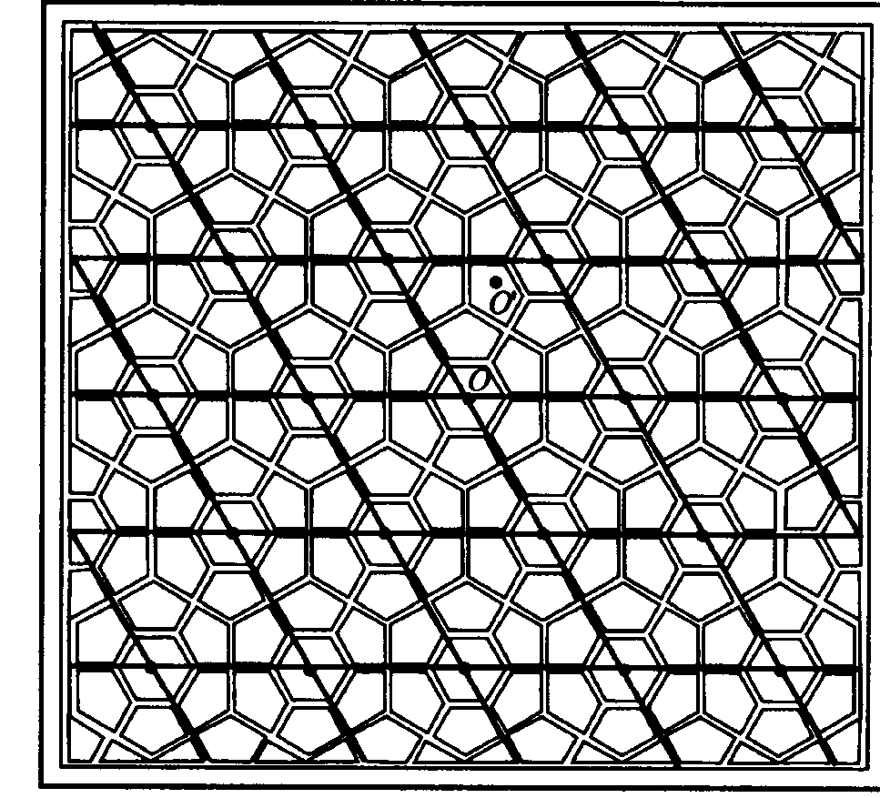
Crystal structure
Periodically placed building blocks (atoms, molecules, ions…)
  Translational symmetry of the basis
  Proved by X-ray
  diffractions
Crystal: basis + lattice
  Or basis in the
  primitive cell + Bravais lattice
Why many high quality
solid samples have long
range ordering at low
temperature?

Slide 22
Bravais Lattices
A regular periodic arrangement of points in space.
  tn=n1t1+n2t2+n3t3
  t1, t2,t3: primitive vectors
  n1, n2, n3: integers
  t1, t2, t3 form primitive cells.
  Volume of primitive cell:
    V= t1∙(t2xt3)
  Right handed system
  The primitive cell contains one lattice point, smallest cell
Question: The choice of the primitive vectors is unique or not?

Slide 23
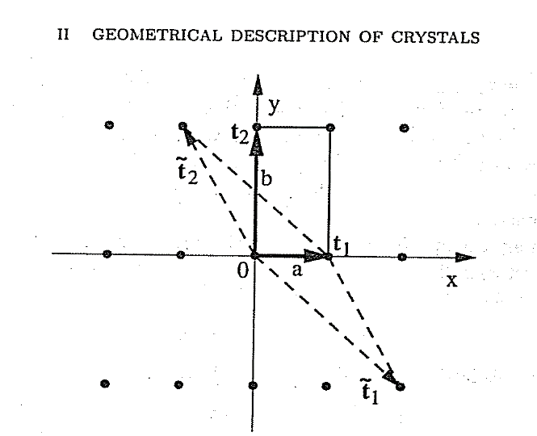
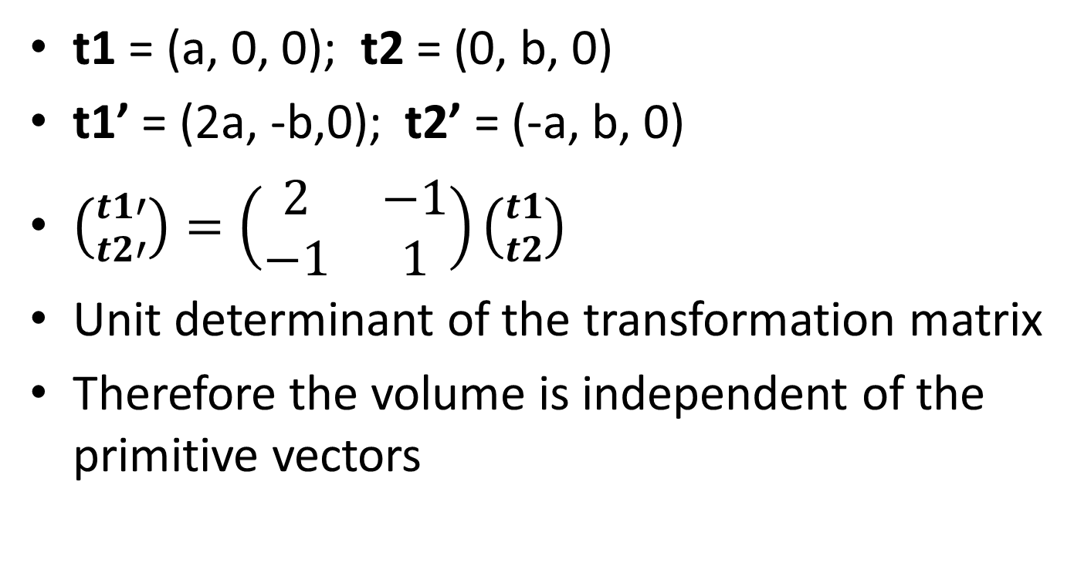
The choice of the primitive vectors is unique or not?
t1 = (a, 0, 0); t2 = (0, b, 0)
t1’ = (2a, -b,0); t2’ = (-a, b, 0)
$\left({t1′ \atop t2′}\right)=\left(\begin{matrix}2 & −1 \\ −1 & 1\end{matrix}\right)\left({t1 \atop t2}\right)$
Unit determinant of the transformation matrix
Therefore the volume is independent of the primitive vectors

Slide 24
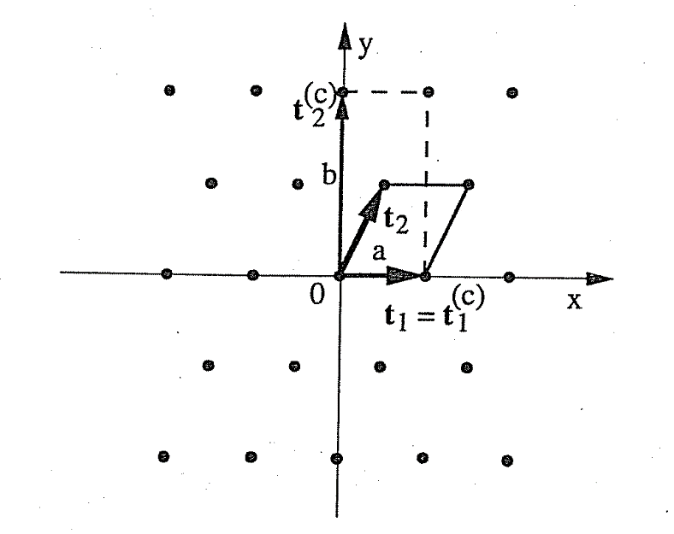
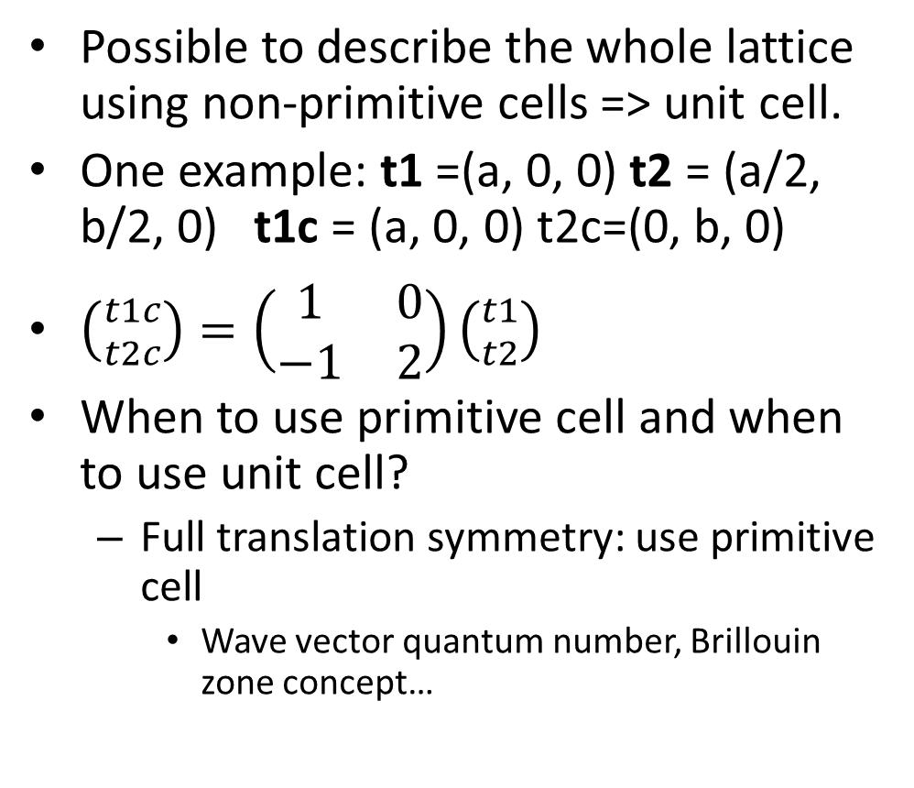
Unit Cell
Possible to describe the whole lattice using non-primitive cells => unit cell.
One example: t1 =(a, 0, 0) t2 = (a/2, b/2, 0) t1c = (a, 0, 0) t2c=(0, b, 0)
$\left({t1c \atop t2c}\right)=\left(\begin{matrix}1 & 0 \\ −1 & 2\end{matrix}\right)\left({t1 \atop t2}\right)$
When to use primitive cell and when to use unit cell?
  Full translation symmetry: use primitive cell
    Wave vector quantum number, Brillouin zone concept…

Slide 25
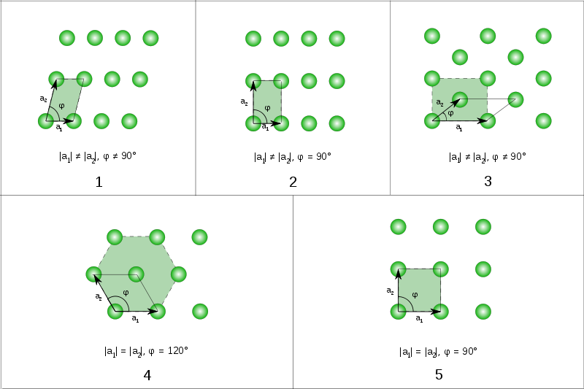
1 oblique (1, 2), 2 rectangular (1m 2mm) including 3 centered rectangular (rhombic) , 4 hexagonal (3, 3m, 6, 6mm) , 5 square (4, 4m)

Slide 26
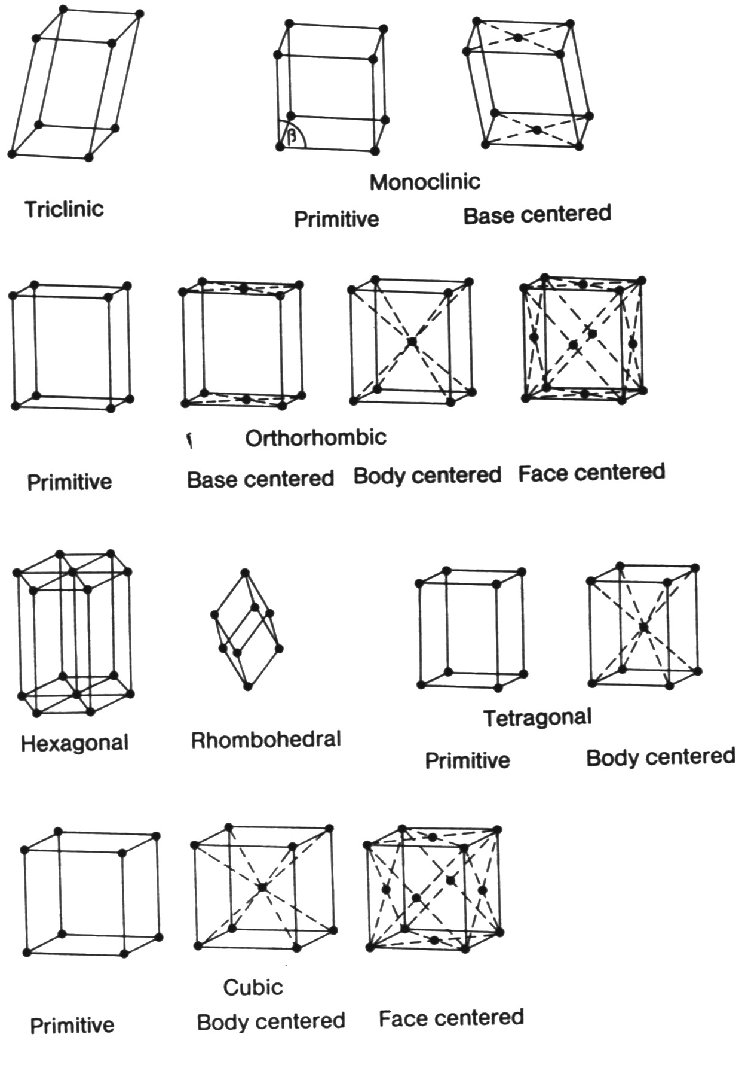

Slide 27
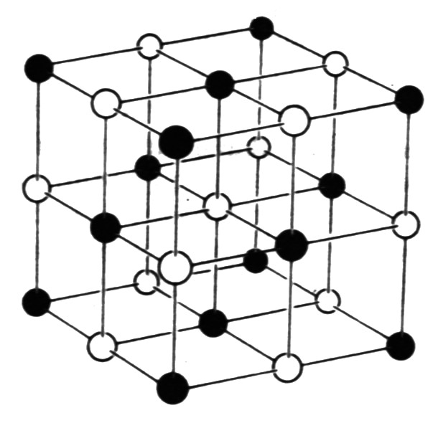
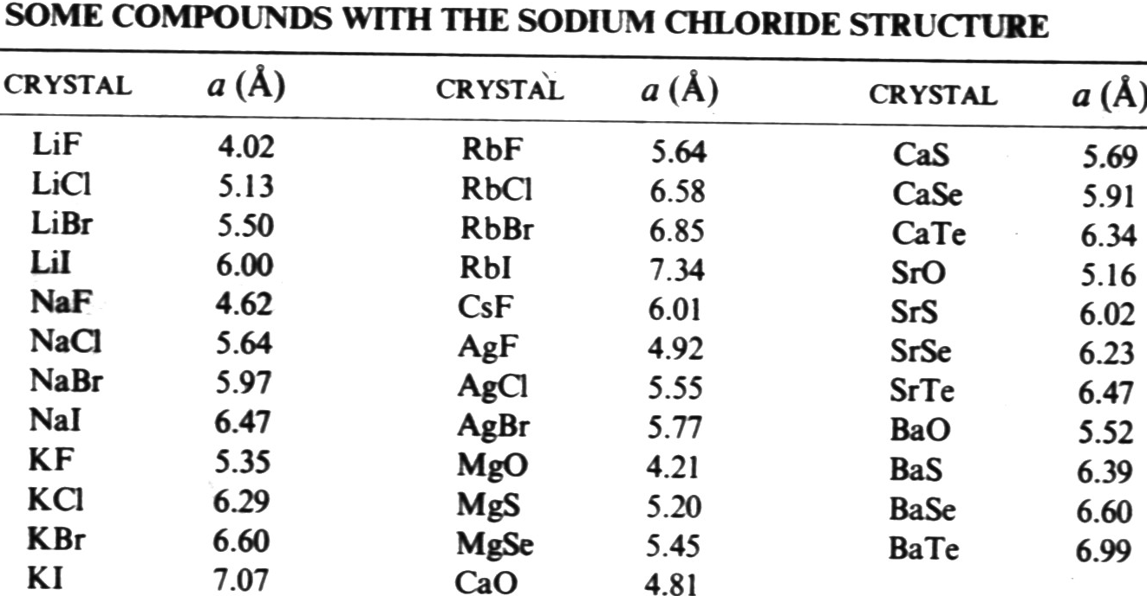
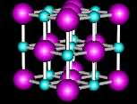

Slide 28
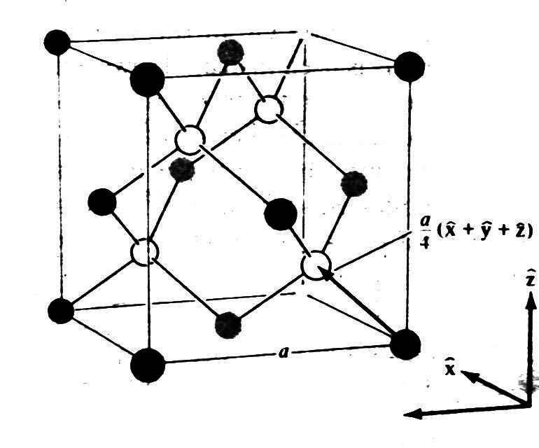
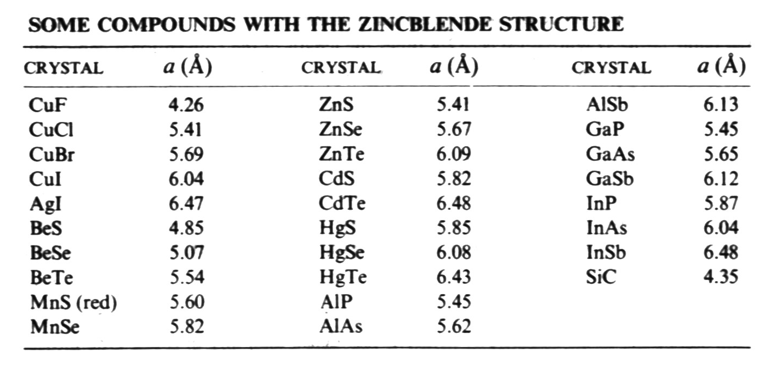
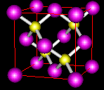
Diamond and Zincblende

Slide 29
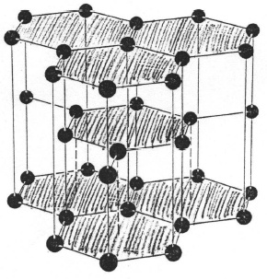
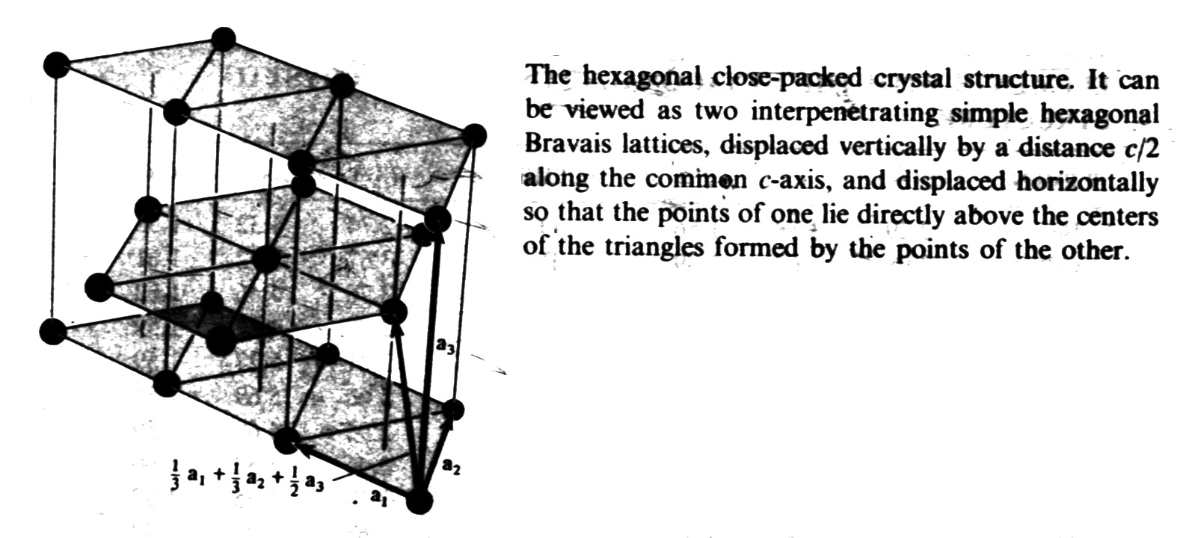
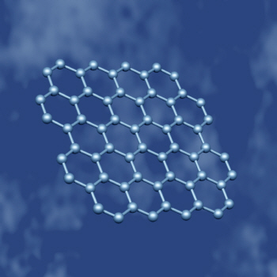
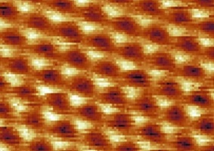
ABABAB stacking
Packing fraction: the maximum ratio of the volume of hard balls that occupy the lattice points to the total volume
Graphene (Scienc 306,666,2004)

Slide 30
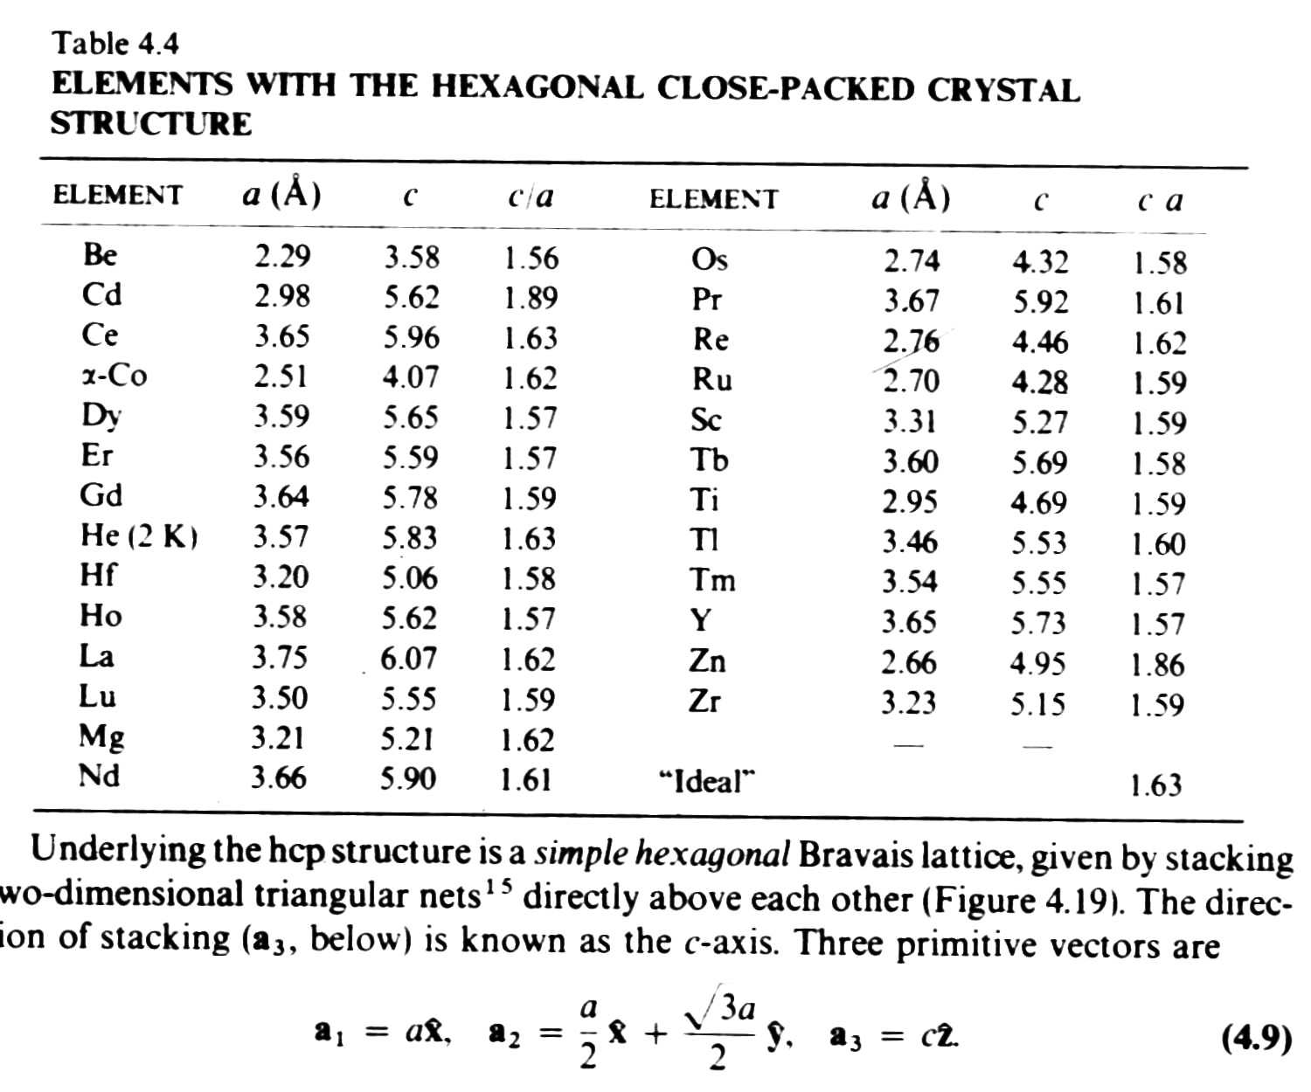

Slide 31
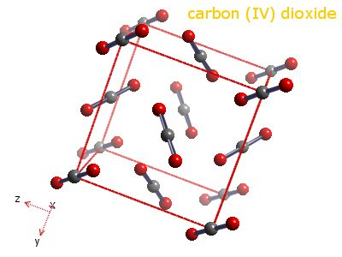

Slide 32
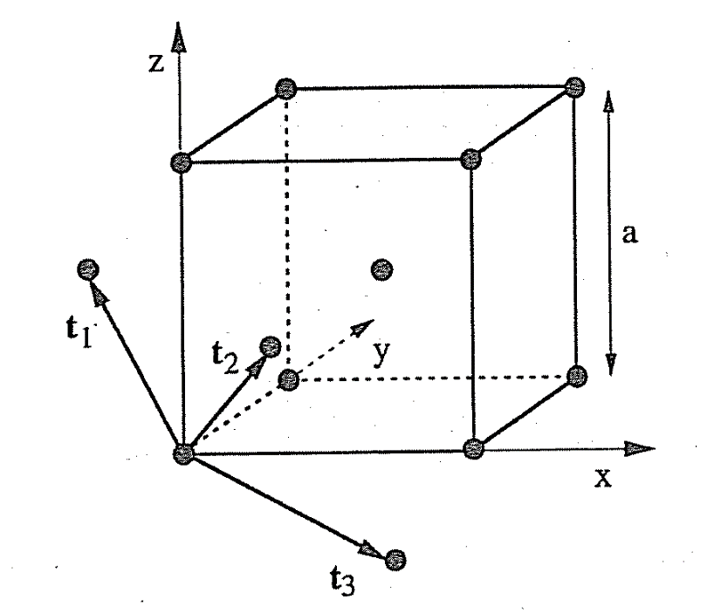
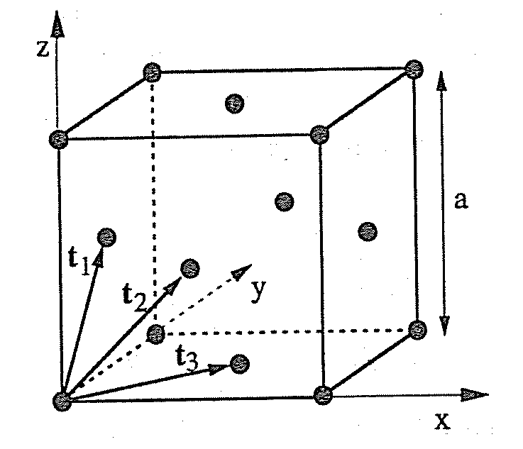
Geometrical description of some crystal structures
Fcc: t1 = a/2(0,1,1) t2= a/2(1,0,1) t3=a/2(1,1,0)
Bcc: t1 = a/2(-1,1,1) t2= a/2(1,-1,1) t3=a/2(1,1,-1)

Slide 33
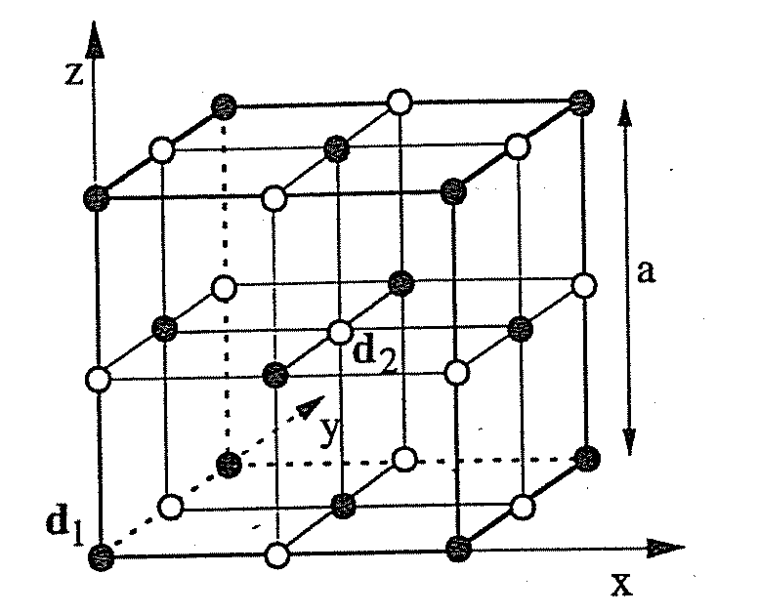
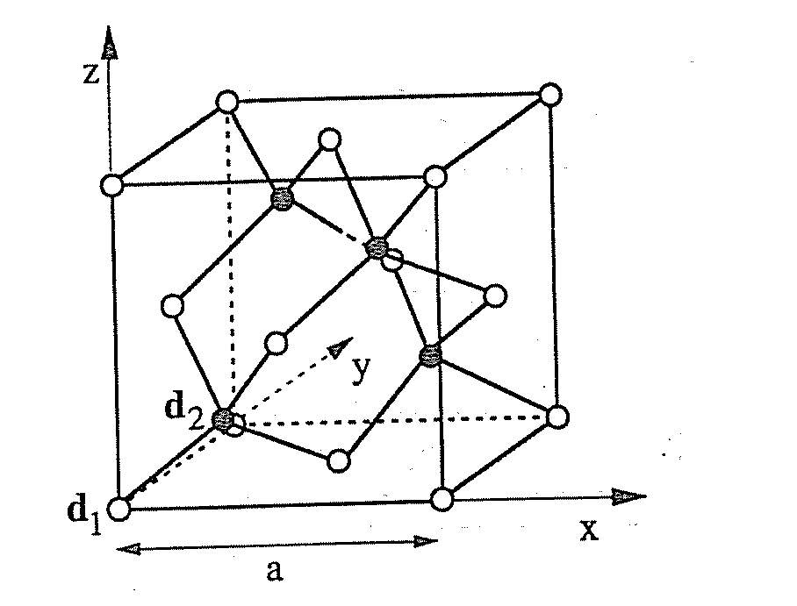
NaCl: t1 = a/2(0,1,1) t2= a/2(1,0,1) t3=a/2(1,1,0), d1 = 0, d2 = a/2(1,1,1)
Diamond structure and zincblende structure
t1 = a/2(0,1,1) t2= a/2(1,0,1) t3=a/2(1,1,0), d1 = 0, d2 = a/4(1,1,1)

Slide 34
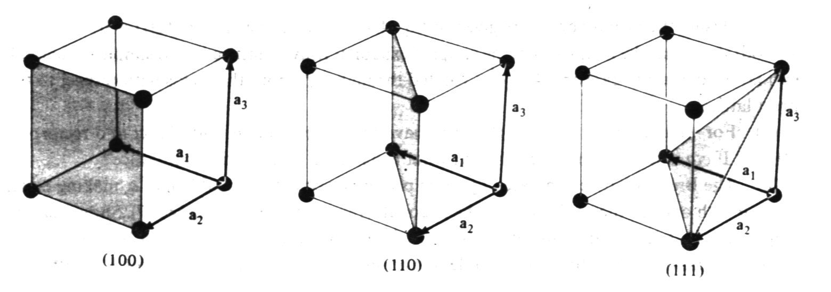

Crystal direction： [l₁,l₂,l₃] l₁ a₁+l₂ a₂+l₃ a₃
equivalent: <l₁l₂l₃>
By convention, negative index are written with a bar, as in $\overline{3}$ for −3
Crystal planes (h₁,h₂,h₃) ：Miller index
a₁/ h₁， a₂/ h₂，a₃/ h₃.
equivalent {h₁,h₂,h₃}
a₁ a₂ a₃ are unit cell vectors!

Slide 35
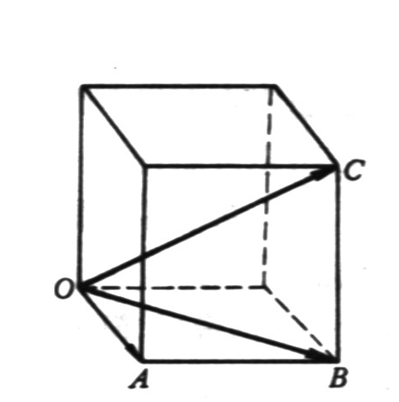
Crystal direction for a simple cubic

Slide 36
Sample code for a simple cubic lattice
Input: cell size (L_{x} ´ L_{y} ´ L_{z}) = (n_{x} ´ n_{y} ´ n_{z})a³ , a --- lattice constant.
Sc: Na = 0 (no. of atoms)
i=1, n_{x}
j=1, n_{y}
k=1, n_{z}
Na = Na +1
x(Na) = 0.0 + (i-1)*a
y(Na) = 0.0 + (j-1)*a
z(Na) = 0.0 + (k-1)*a
Next k
Next j
Next i
Nt(Sc) = Na (total no. of Sc atoms)

Slide 37
Project A part I: Programming Sc, Bcc, Fcc, and Diamond crystalline structures.
Detailed requirements:
The simulation cell size is adjustable in both periodicity and lattice constant. The shape of the cell has to be cubic like (or tetragonal). Make sure to include correct number of atoms in your cell. Plot the structure using any graphic software, like VMD…
Score will be deducted if the program has bad variable/function naming conventions or without adequate comments. Email the code and output to Wenjing directly.
Project is due two weeks after the lab. Score will be deducted if the submission is late.

